Slide 1
Insuchef
Meal Magicians / S2G7

Slide 2
Introduction
What Is InsuChef?
InsuChef is an application that designed to help people with diabetes. The InsuChef application will help people with diabetes by enabling users to calculate the total carbohydrate that is consumed and calculate the sufficient amount of insulin that needs to be taken and when. There will also be other features that facilitate the lives of diabetic people.

Slide 3

Launch page
This is the Launch Page. The Launch Page will be shown to the user for a short time when the application is opening. Afterward, the user will be sent to the home page.

Slide 4
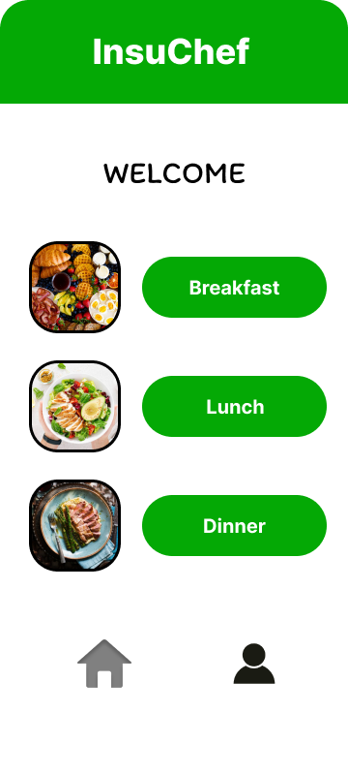
home page
This is the Home Page. On the Home Page user will be able to choose which meal will be eaten. After pressing one of the buttons, the user will be sent to the Meal Selection Page to select the meals. On the Home Page, there will also be navigation buttons at the bottom. In the navigation bar, the first button will send the user to the Home Page. The second button will send user to the Profile Page.

Slide 5
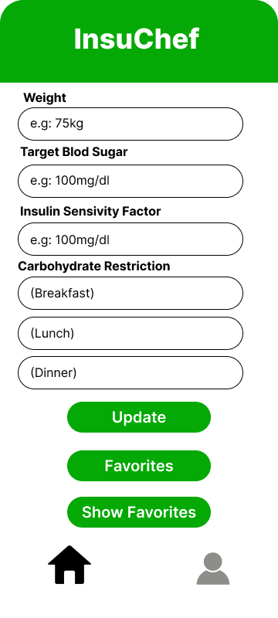
Profile Page
This is the Profile Page. On the Profile Page, some information that is optional will be taken from the user. If the user inputs this information, by pressing the Update button this information will be updated. If the user presses the Favorites button, the user will be sent to the Favorites Page to choose the favorite meals. If the user presses Show Favorites button, favorite meals will be shown to the user.

Slide 6
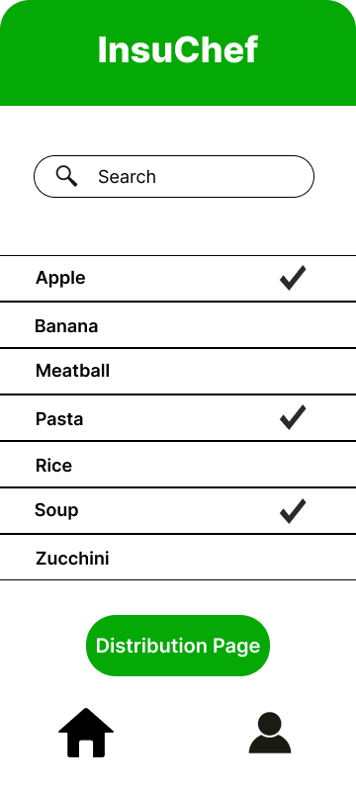
Meal selection page
This is the Meal Selection Page. On the Meal Selection Page, users will select which meals they eat. In order to do that, users can both scroll the list and search it from the Search Bar at the top. After the user choose one of the meals by clicking on the list item, the meal will be shown with a check bar. If the user clicks on the list item for the second time, the check mark will be removed. If the user presses the Distribution Page button, the user will be sent to the Distribution Page.

Slide 7
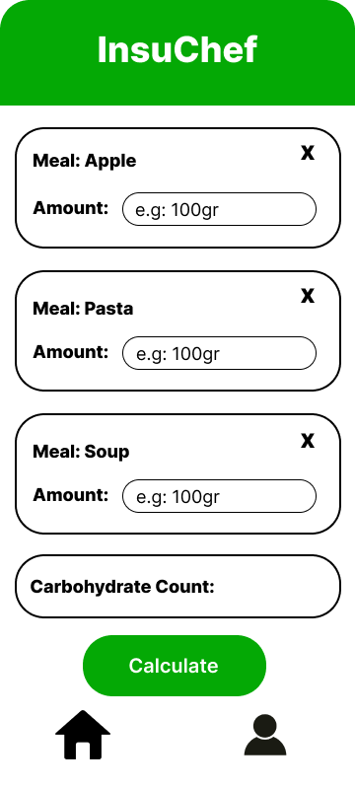
Distribution page
This is the Distribution Page. The user will input the amount of each meal. As the user inputs the amount, the total carbohydrate count will be shown at the bottom to inform the user. The cross buttons will be used to cancel the meal. If the user presses the Calculate button, the user will be sent to the Calculation Page.

Slide 8
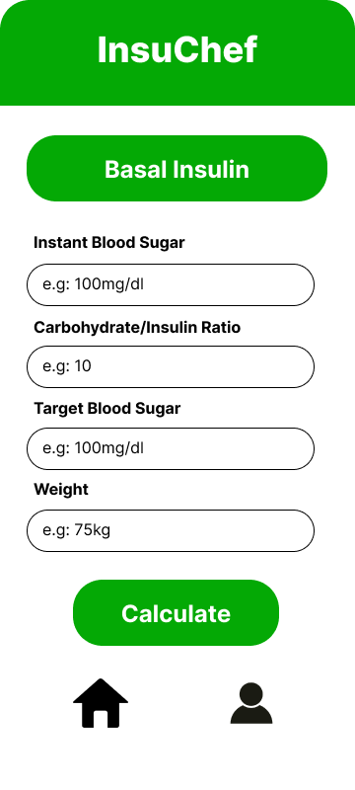
Instant Information page
This is the Instant Information Page. The user will input the instant information on the Instant Information Page, such as instant blood sugar and carbohydrate/insulin ratio. The other two pieces of information will be filled in if the user already input this information in the Profile Page. If the user presses Calculate button, the user will be sent to the Calculation Page.

Slide 9
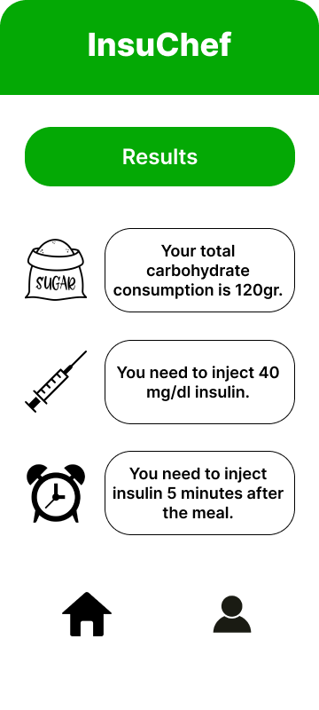
Calculation page
This is the Calculation Page. On the Calculation Page, the results of the calculations will be shown to the user under three categories; carbohydrate consumption, insulin dose, and time. After that user will return to the Home Page by clicking the Home Page button at the navigation bar.

Slide 10
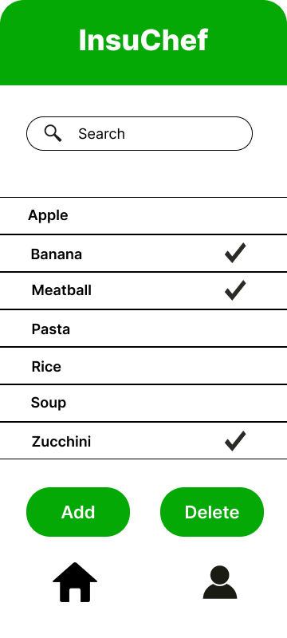
Favorites page
This is the Favorites Page. On the Favorites Page, users will be able to choose their favorite meals and add them to the Favorites list by using the Add button. Also, users will be able to delete their favorite meals as well by using the Delete button. As it is on the Meal Selection Page, users can both scroll the list and search it from the Search Bar at the top. Additionally, as it is on the Meal Selection Page, the selected items will be shown with a check mark.

Slide 11
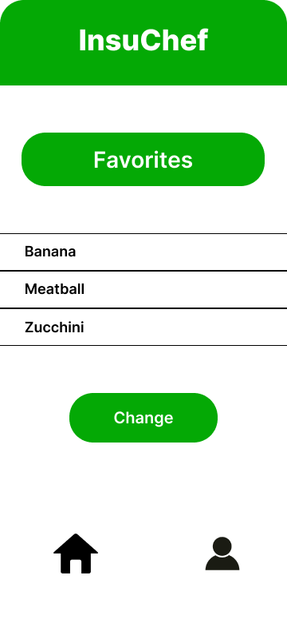
Show favorites page
This is the Show Favorites Page. On the Show Favorites Page, the favorite meals will be shown to the user, and these favorite meals will be on top of the list when users search for meals on the Meal Selection Page. If the user presses the Change button, the user will be sent to the Favorites Page to either add or delete favorites.

Slide 12


Additional ui materials
The first item is called a Snackbar. Snackbars provide lightweight feedback about an operation. They show a brief message at the bottom of the screen on mobile devices (1).
The second item is called a Toast Message. A toast provides simple feedback about an operation in a small popup (2).

Slide 13
conclusıon
When we designed this application, we tried to keep it as simple as possible since diabetes is a disease that affects people of all ages. Hence, the InsuChef application, with its user-friendly interface, will help diabetic people to make their insulin and carbohydrate consumption calculations easier.

Slide 14
References
1) “Toasts Overview: Android Developers.” Android Developers, https://developer.android.com/guide/topics/ui/notifiers/toasts#:~:text=A%20toast%20provides%20simple%20feedback,automatically%20disappear%20after%20a%20timeout.
2) “Snackbar: Android Developers.” Android Developers, https://developer.android.com/reference/com/google/android/material/snackbar/Snackbar#:~:text=Snackbars%20provide%20lightweight%20feedback%20about,be%20displayed%20at%20a%20time.

Slide 15
Emine Fidan
Umay Dündar
Edip Emre Dönger
Elif Ercan
Yiğit Kemal Can

